Slide 1
Transmission Impairments

Slide 2
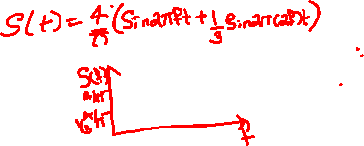
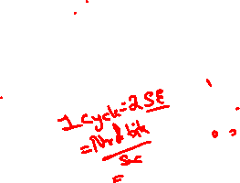
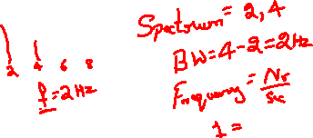

Slide 3
Transmission Impairments
› Signal received may be different from signal transmitted causing:
⁾ Analog: degradation of signal quality
⁾ Digital: bit errors
› Most significant impairments:
1.Attenuation and attenuation distortion
2.Delay distortion
3.Noise

Slide 4

Attenuation
› Signal strength reduces as a function of distance
› Designing a transmission system:
Received signal has sufficient strength to be interpreted by receiver electronics
Received signal is significantly higher than received noise to avoid errors
Attenuation is different at different frequencies
Apply equalization to overcome

Slide 6

Delay Distortion
› Component signals with different frequencies have different propagation delay through cable
› Some signal components representing a bit interfere with neighbour bits: intersymbol interference
› Apply equalization to overcome

Slide 7
Noise
Thermal Noise
› Due to thermal agitation of electrons
› Present in all transmission devices and media
› Function of temperature:
N = kTB
where k = Boltzmann’s constant = 1.38 × 10⁻²³ J/K, B is bandwidth and T is temperature in kelvins
Intermodulation Noise
› Caused when signals of different frequencies share the same medium

Slide 8
Noise
Crosstalk
› Unwanted coupling of different signals
Impulse Noise
› Short peak of noise, e.g. lightning, electrical disturbances, flaws in communications system

Slide 9
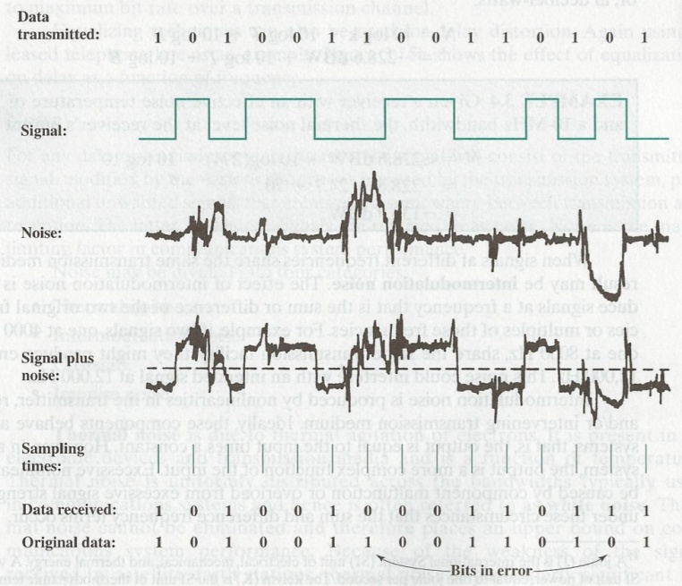

Effect of Noise on a Digital Signal

Slide 10
Channel Capacity

Slide 11
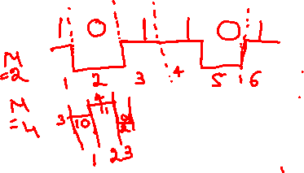

Slide 12
Channel Capacity
› Channel capacity: maximum data rate at which data can be transmitted over a given communication channel
› Relate:
⁾ Data rate, C [bits per second]
⁾ Bandwidth, B [Hertz]
⁾ Noise
⁾ Error rate
› Two theoretical models:
Nyquist Capacity:assumes noise-free environment
Shannon Capacity:considers noise

Slide 13
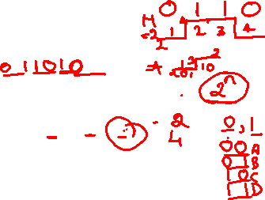
Nyquist Capacity
› Assumes channel that is noise free
› Given a bandwidth of B, the highest signal rate is 2B
› Single signal element may carry more than 1 bit; signal with M levels may carry log₂ M bits
C = 2B log₂ M
› Tradeoffs:
⁾ Increase the bandwidth, increases the data rate
⁾ Increase the signal levels, increases the data rate
⁾ Increase the signal levels, harder for receiver to interpret the bits (practical limit to M)

Slide 14
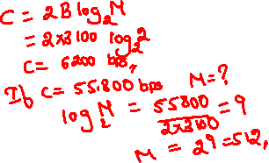
Example of Nyquist Capacity
A telephone system with modem allows bandwidth of 3100 Hz. What is the maximum data rate? M=2

Slide 15
Shannon Capacity
› With noise, some bits may be corrupted; higher data rate, more bits corrupted
› Increasing signal strength overcomes noise
› Signal-to-noise ratio:
signalpower
SNR =
noisepower
Shannon capacity:
C = B log₂ (1 + SNR)
Tradeoffs:
Increase bandwidth or signal power, increases data rate
Increase of noise, reduces data rate
Increase bandwidth, allows more noise
Increase signal power, causes increased intermodulation noise

Slide 16
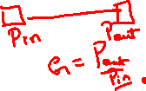

Slide 18
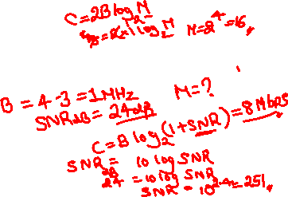
Example of Shannon and Nyquist Capacity
A channel uses spectrum of between 3MHz and 4MHz, with SNR_{dB} = 24dB. How many signal levels are required to achieve Shannon capacity?

Slide 20
Example
A channel has B=4kHz and SNR =30dB. Determine maximum information rate for 128 level encoding.

Slide 21
Solution
Nyquist capacity=56kbps
Shannon capacity=39.8kbps
Smallest of two values decide channel capacity.

